Slide 1
Supabase project

Slide 2
What we are going to do
In our Supabase and Vite project, we have successfully connected the Vite UI, which utilizes TypeScript, with the Supabase SQL database. We have already demonstrated an example of fetching data.
Now, we are going to create a new project that involves a one-to-many relationship between countries and cities. For each country, there will be multiple cities associated with it.
In this project, we will implement the CRUD operations (create, read, update, delete) for both countries and cities. This means we will be able to create, update, and delete countries and cities as needed.

Slide 3
Create the tables
Firstly, we will create the necessary tables. We'll start by creating the "country" table, which will consist of an auto-generated "id" column and a "text" column that cannot be null.
Secondly, we will create the "city" table, which will establish a relationship with the "country" table. The structure of the "city" table will be as follows:
"city_id" (auto-generated integer)
"country_id" (referring to the corresponding country)
"city_name" (text)

Slide 4
Connect vite and supabase
Next, we will establish the connection between the two projects by retrieving the supabaseUrl and supabaseKey from the Supabase dashboard.
To achieve this, we will use the provided supabaseUrl and supabaseKey to create a Supabase client object using the createClient function. Here's an example of how to do it:
const supabase = createClient(supabaseUrl, supabaseKey);
By passing the supabaseUrl and supabaseKey as arguments to createClient, we can create an instance of the Supabase client, which will allow us to interact with the Supabase API and perform various database operations.

Slide 5
CRUD
Let's proceed with creating asynchronous functions to handle data operations such as fetching, creating, inserting, and deleting.
getCountries, deleteCountry, insertCountry, createCountry

Slide 6
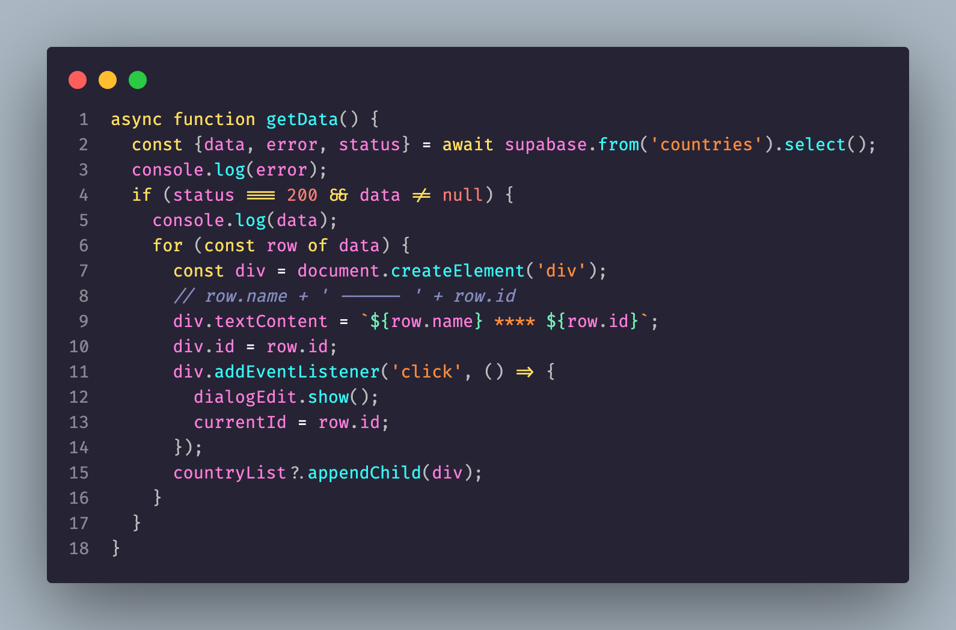
getData

Slide 7
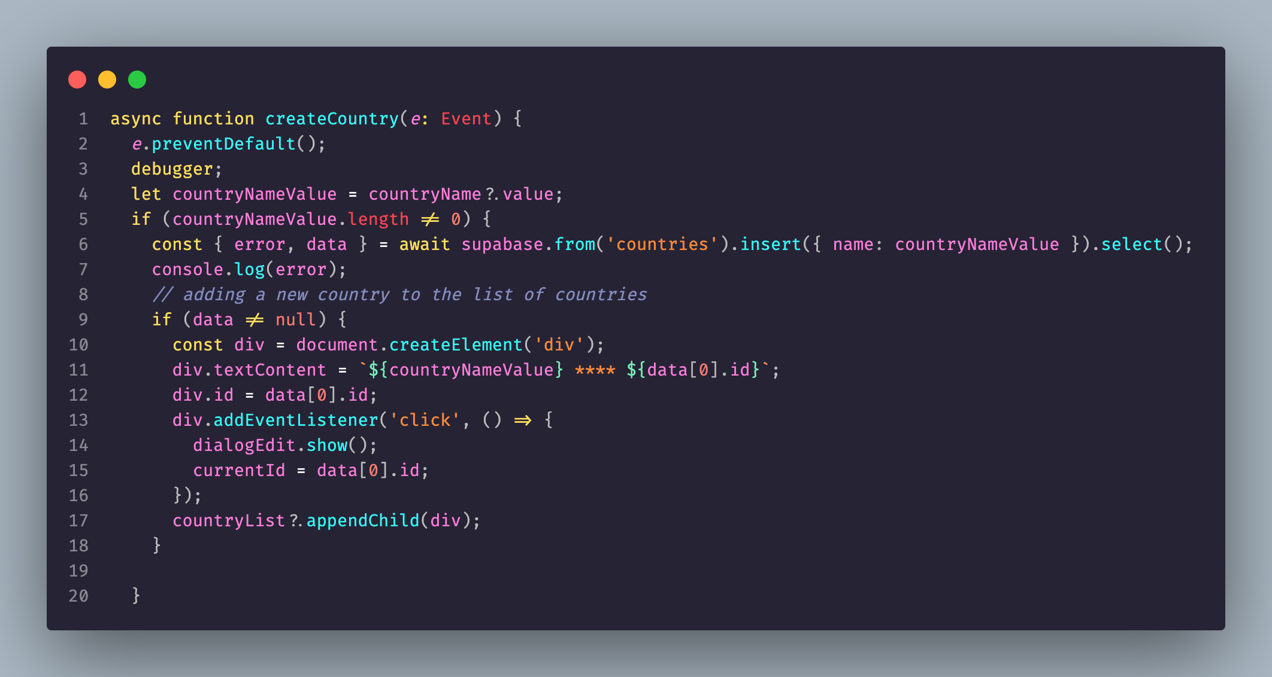
Create data

Slide 8
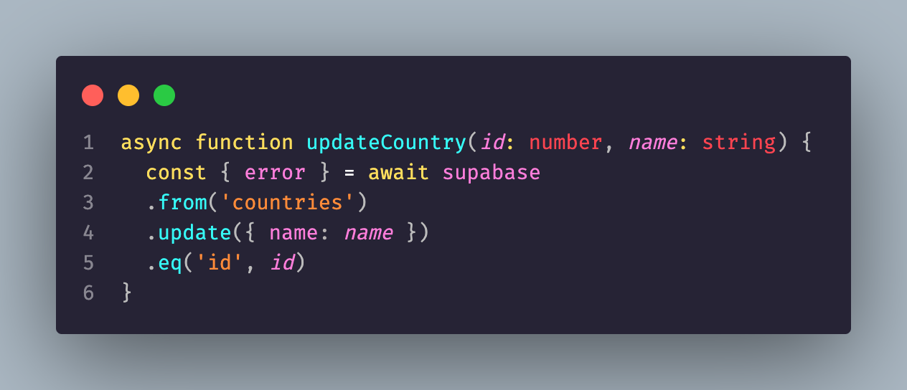
Update data

Slide 9
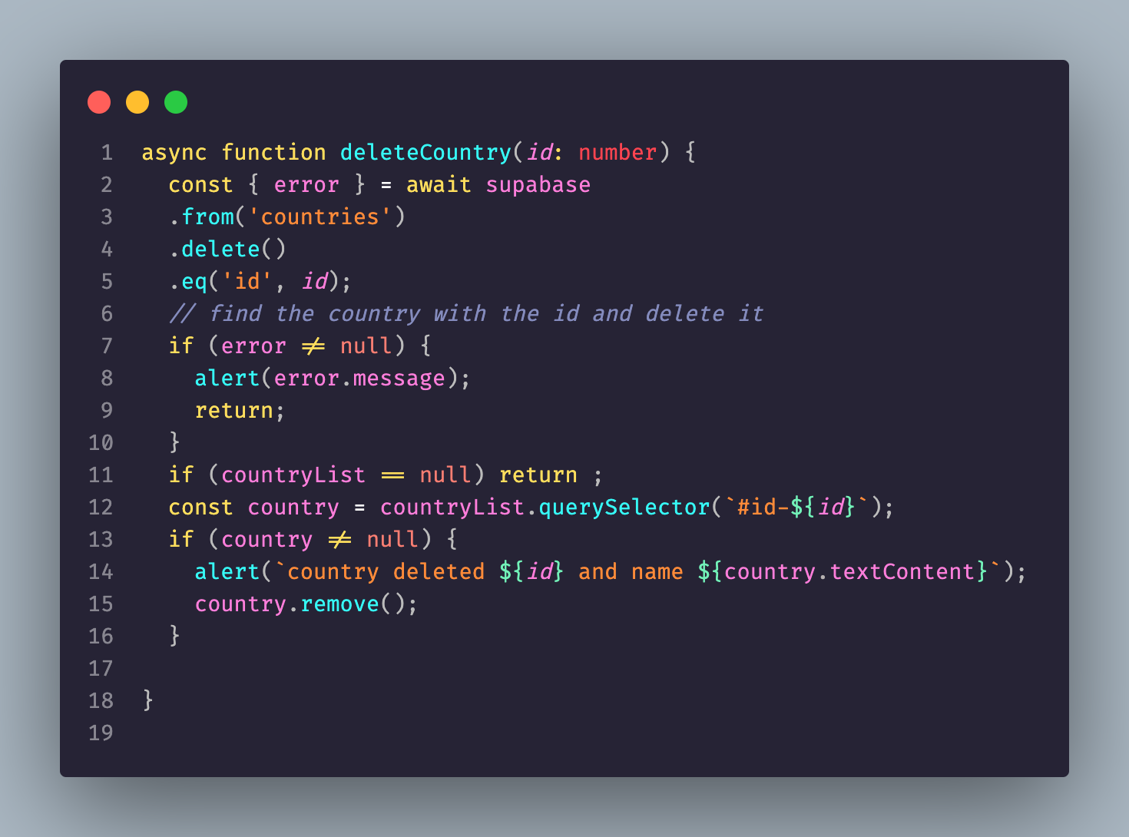
Delete data

Slide 10
Import types- login first
npm i supabase@">=1.8.1" --save-dev
npx supabase login
-- you can get the access token from the supabase dashboard at https://app.supabase.com/account/tokens

Slide 11
Second steps gen types
npx supabase gen types typescript --project-id "project id is the reference id" --schema public > ./src/lib/schema.ts
--you can find it in the general settings of your project

Slide 12
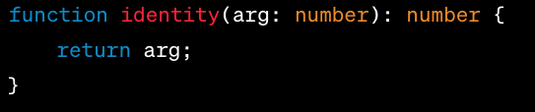
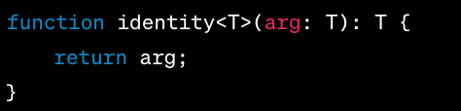
generics
Generics is a concept in TypeScript (and other languages such as Java, C#, etc.) that allows the creation of reusable code components that can work over a variety of types rather than a single one.
This allows users to consume these components and use their own types.

Slide 13
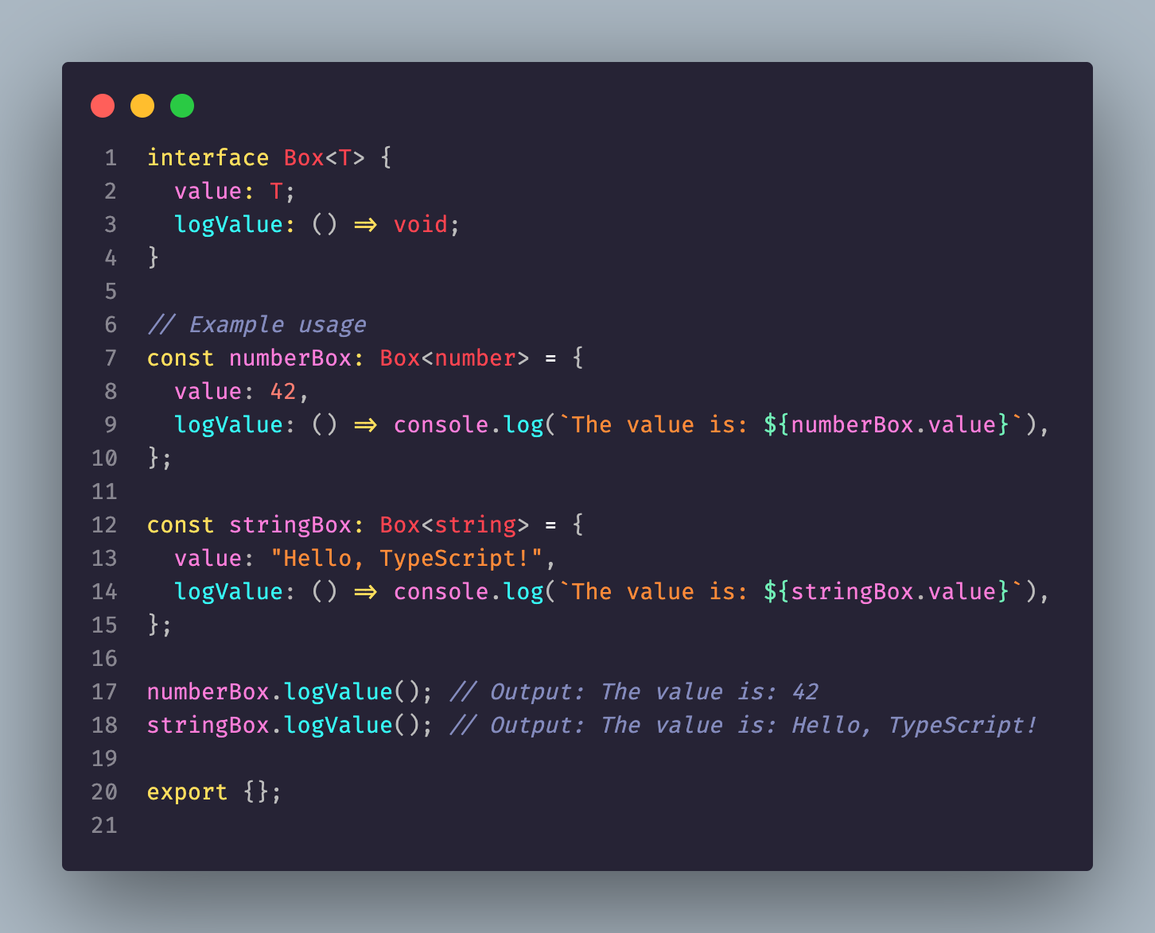
Generic with interface
In TypeScript, generics provide a way to create reusable components that can work with different types. When combined with interfaces, generics allow you to define flexible and type-safe structures.

Slide 14
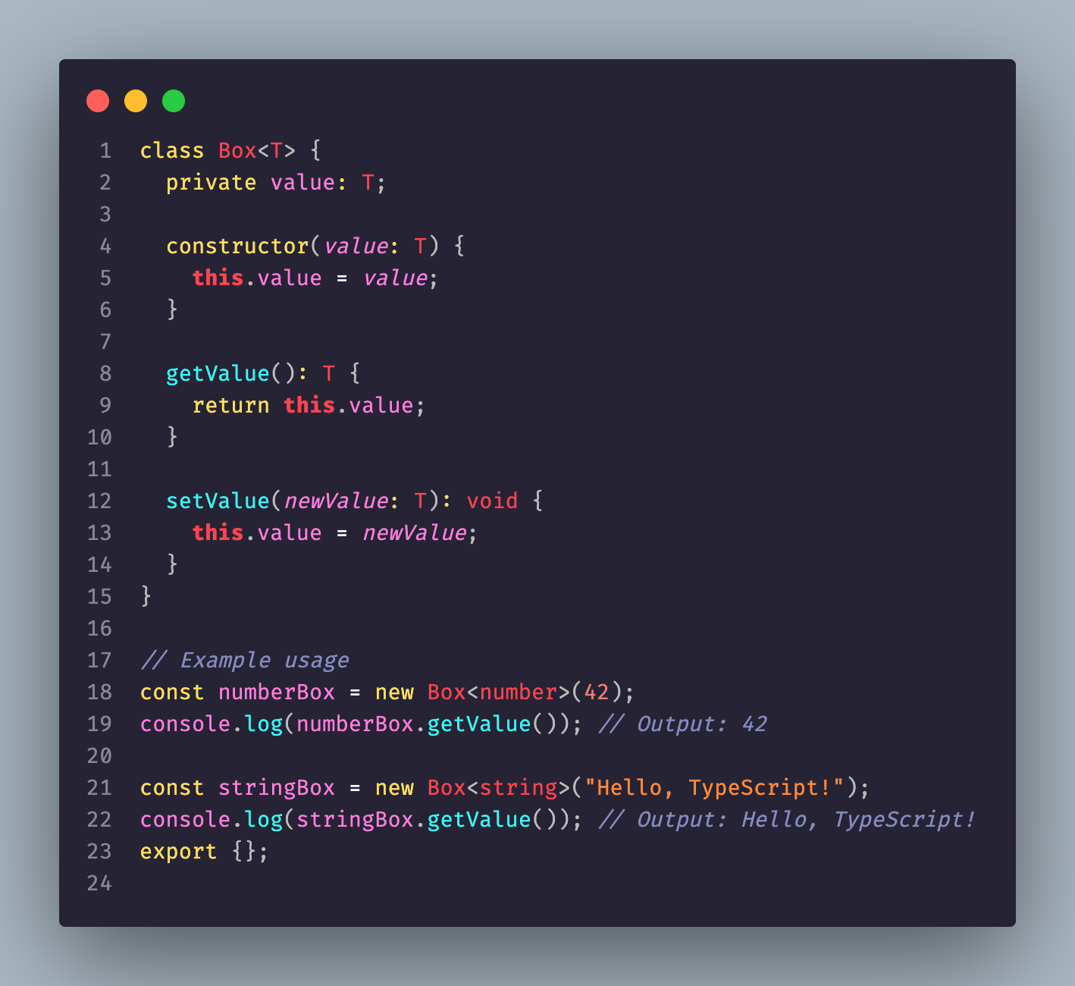
Generic classes
Generics with classes in TypeScript allow you to create reusable classes that can work with different types. You can define a generic class by specifying a type parameter that can be used throughout the class definition. Here's an example:

Slide 15

Proxy
In TypeScript, the Proxy is a built-in feature that allows you to create objects with custom behavior for fundamental operations like property access, assignment, function invocation, and more. It provides a way to intercept and modify the behavior of these operations on an object.
The Proxy object serves as a wrapper around another object and can intercept operations performed on that object. It enables you to define custom behavior for these operations by providing a set of methods (known as traps) in a handler object.
To create a Proxy in TypeScript, you use the Proxy constructor. It takes two main parameters: the target object and the handler object. The target object is the object you want to proxy, and the handler object contains the methods (traps) that intercept the operations.

Slide 16
handler
get(target, property, receiver): Intercepts property access on the target object. It is called when a property is read.
set(target, property, value, receiver): Intercepts property assignment on the target object. It is called when a property is modified.
apply(target, thisArg, argumentsList): Intercepts function invocation on the target object. It is called when a function is called as a method.
construct(target, argumentsList, newTarget): Intercepts object instantiation using the new keyword. It is called when an object is created with the new operator.
has(target, property): Intercepts the in operator. It is called when checking for the existence of a property using the in operator.
deleteProperty(target, property): Intercepts property deletion on the target object. It is called when a property is removed using the delete operator.

Slide 17
Map
In TypeScript, Map is a built-in object type that stores key-value pairs in the order of their insertion. A Map object iterates its elements in insertion order, which can be very helpful in situations where order is important.
The Map type in TypeScript is very similar to the Map type in JavaScript. However, TypeScript allows you to specify the types of the keys and values when you create the Map, which provides type safety.

Slide 18
Typescript interface vs Map
Interfaces and Maps in TypeScript are both used to organize data, but they serve different purposes and have different characteristics:
An interface in TypeScript is a way to define a contract for a particular structure of an object. It helps to check that a particular object fits the specified structure. It's a compile-time construct and hence it will not have generated code as JavaScript doesn't have the concept of interfaces.
A Map in TypeScript (as in JavaScript) is a data structure that allows you to store key-value pairs. It is a runtime concept, unlike interfaces. The keys and values in a Map can be of any type, not just strings or numbers.

